Slide 1
Writing Papers in the Biological Sciences
An introduction to Biological research and paper writing

Slide 2
Chapter Three: Using Tables and Figures
Important Guidelines:
Simplify message without falsifying data
Generally need either graph or table
Present with clarity, brevity
Note prior conventions (take your time!)

Slide 3
Data Presentation
What types of data presentation formats do you know and you need to do?
How are they different?

Slide 4
Data Presentation Formats
Tables
  Specific data
  Exact comparisons between data points
Bar Charts
  Less numerically specific
  Examine differences rather than trends/changes
  Comparisons of size, magnitude, amounts
Line Graphs
  Not numerically specific
  Demonstrate movement, change, trends
  Generally over time or concentration

Slide 5
Using a Table
Should be able to stand on its own
Show data, and possible manipulations
  Percentages, totals, means, averages, ratios, etc.
  Columns contain Individual Variables (that which was manipulated)
  Make the contents concise
  Use logical Format
  Table should agree with the rest of the papers (Data).

Slide 6
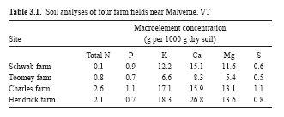
Good Table
Legend- complete
Stands on own
Note capitalization
Period after "Table 2"
Units included
Legend above the table;
Note clarifying footnote
Lines of demarcation separate numerical data from text.
Gridlines not present

Slide 7
More on Tables
Limit total items/columns
  (But more than than 6-8 datapoints)
No vertical lines
Do not overload with headings
Use captions/footnotes for definitions
Strings of “0’s” or unchanging data might not be included
Use restraint with decimal places
Obvious abbreviations can be included
Don’t repeat data in text, just call attention to main points

Slide 8
Preparing a Table: Format
Examine style sheet and examples
One table, one page, double spaced
Use Arabic numerals to number
Group so that comparisons run down column
Logically group data to stress baseline and trends
Round off numbers and align decimals
Create a descriptive caption (no verb required)
Use head- or foot-notes to explain abbreviations
Verify all data
Verify accuracy of use of symbols
Use consistent labeling throughout paper
Proofread carefully

Slide 9
Tables in a Poster/Presentation
Time limitations- make more simple
Utilize color, shapes, to emphasize
Symbols are okay
Use hints on the table for important data (Get attention!!)
Use publisher’s recommendations
Can use Word or Excel.

Slide 10
Figures
Illustrations
Photographs
Drawings
Flowcharts
Line graphs
Bar graphs
Pie charts
Maps

Slide 11
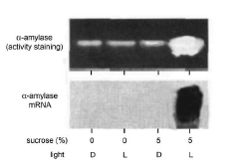
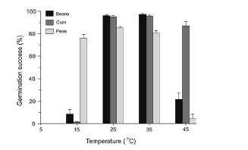
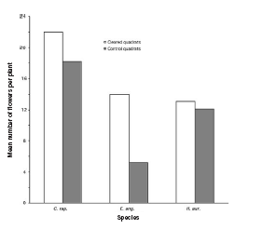
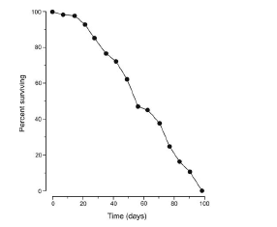

Slide 12
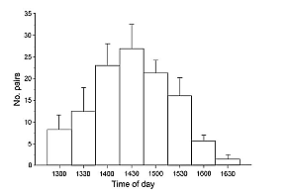
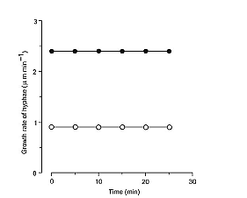
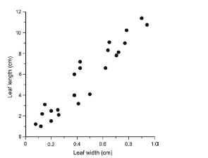

Slide 13
Figures
Designed to add understanding of information that it difficult to convey with words
Must be clear, accurate, appropriate
Avoid mere decoration
Need a legend (like the tables)

Slide 14
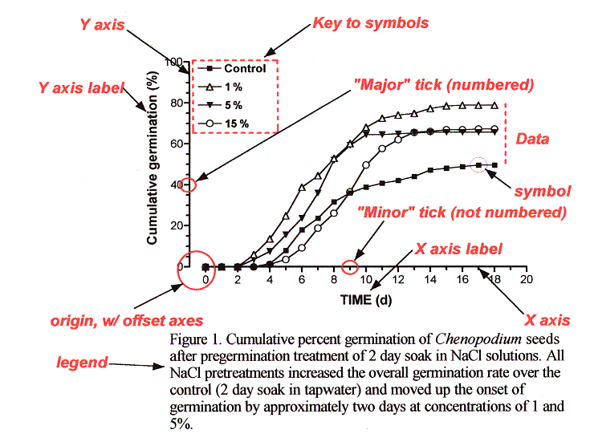
Parts of a Graph (line)

Slide 15
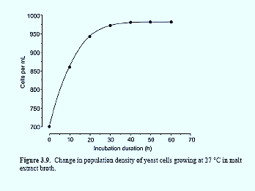
Line Graphs
Should have two axes
Y changes as a function of X
Should show data collected at regular intervals (show trends)
Make curves most bold
Don’t vary line patterns, vary symbols (color on slides/posters)
Plot the length of intervals so that slopes are not too steep.

Slide 16
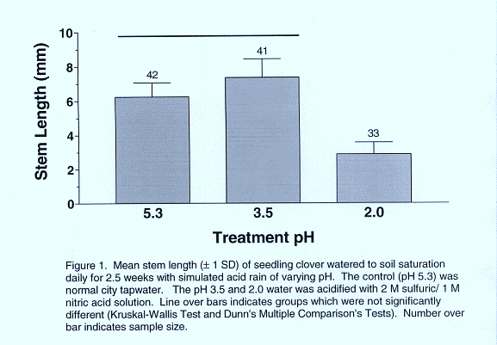
Bar Charts
One measurable axis
Interval doesn’t matter
Make bars wider than the spaces between them.
Use color only in slides/posters.
Use conservative patterns for publication
Show significant differences by letter or asterisk above bars

Slide 17
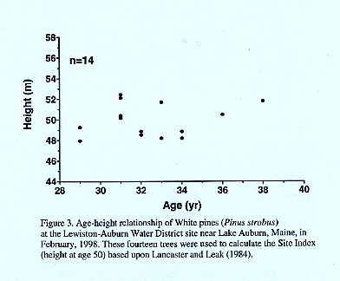
Scatter Plots
Examines individual score on two variables.
Show relationship
Independent Variable on X (“as a function of”)

Slide 18
Recommendations for Figures
Read publishers recommendations regarding size, color, format!
Is it needed?
Do not have a title
Can it be understood at a glance?
Limit curves (3-5) or bars (6-8; 9-10 grouped)
Plot independent variable on X (time, concentration), dependent on Y (what happened?)
Avoid wasted space; legend on field

Slide 19
Recommendations for Figures
Label axes and show units of measure.
Use tics and subtics, to not crowd with numbers
Position, size, shape, length, symbols, angle, color: all are cues (Use when appropriate, and avoid misuse).
For a journal, type caption on a separate page so that the figure can be photographed and the type set separately.

Slide 20
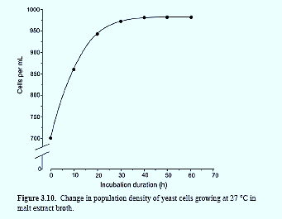

Start scales at “0,” unless you make it clear (tic marks) that you are doing otherwise.

Slide 21
Figure Legends
Must accompany Figures.
Should give pertinent, clarifying information
  key to abbreviations
  sample size
  statistical results
  a brief description of how the data were acquired
Should allow Table/Figure to stand alone
In the legend, both “Table” and “Figure” are spelled out completely

Slide 22
How to refer to a Table/Figure
Every table/figure must be referred to in the text
It is best to refer to them in parenthesis:
  Germination rates were significantly higher after 24 hr water soak than in the control (Fig. 1) .
  DNA sequence homologies for the purple gene from the four congeners (Table 1) show a strong similarity, differing at most by 4 base pairs.
  Note: Fig., here is abbreviated. Not on headings, though.
Avoid sentences that only direct you to the table:
  Table 1 shows the summary results for male and female height at Bates College.

Slide 23
A little more Info…
Figures and tables are numbered independently, in the sequence in which they are referred.
In a thesis or class paper, place them as near where you refer to them as possible
For manuscripts, follow publisher’s directions (historically, legends were are on a separate page)

